Slide 1

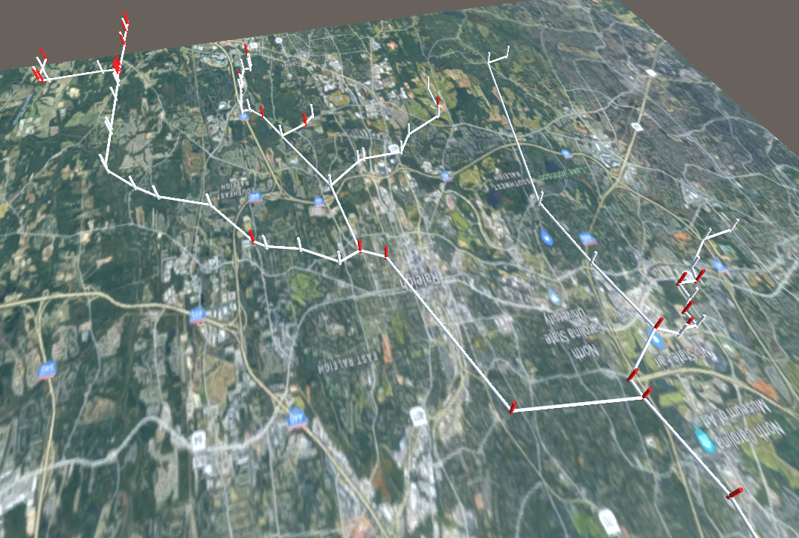


Input Layer
Analysis Layer
3D Engine Layer
3D Engine
Mixed Reality
Digital City Twin for Stormwater Network
Precipitation Hydrograph
Neural network

Slide 2

Input Layer
Analysis Layer
3D Engine Layer
3D Engine
Mixed Reality
Digital City Twin for Stormwater Network
Forecasted Precipitation Hydrograph
Neural Network
Real-Time Forecasted Overflows in the Network
Training Neural Net
Previous Overflows or SWMM

Slide 3
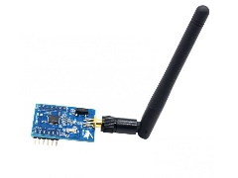
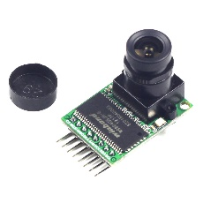
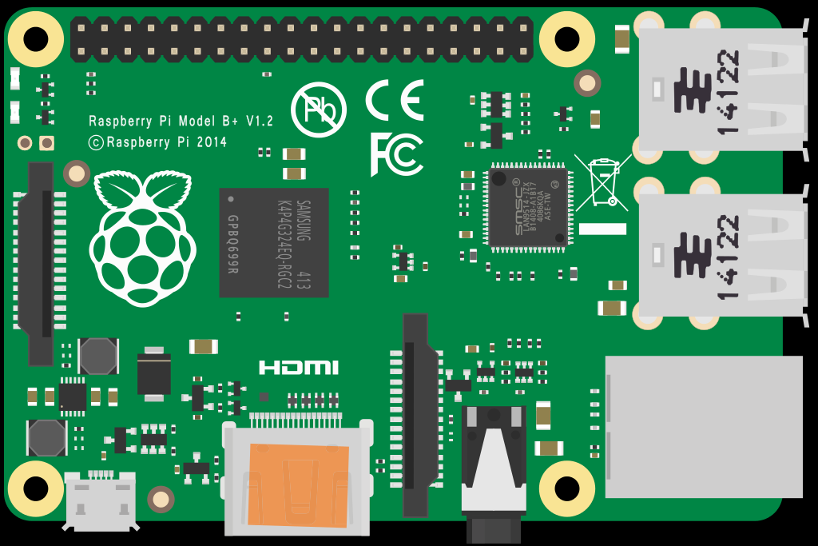




Clients Layer
Server Layer
Sensor Layer
Extracting Image Data
Communication Module (ZigBee)
Raspberry Pi Zero W with ZigBee Module
Access Point (Master Node)
Streaming Server

Slide 4
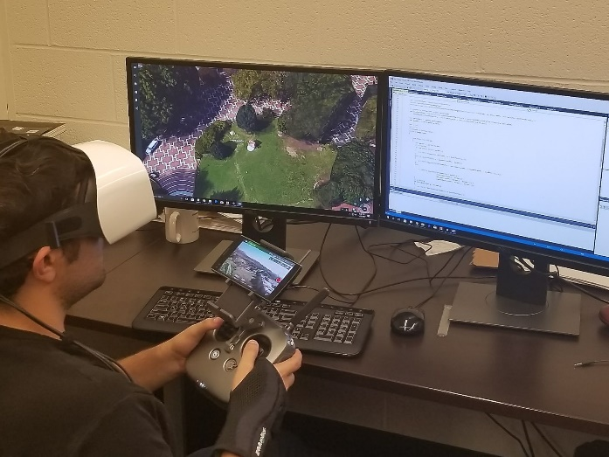
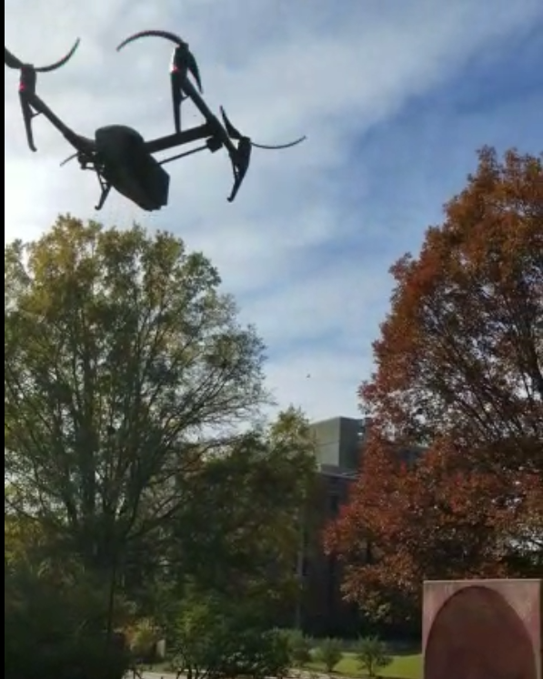

Remote Flight Control
360 Camera with Stre
User Location
Remote Site Location
(To be inspected)
Flight Control Data

Slide 5
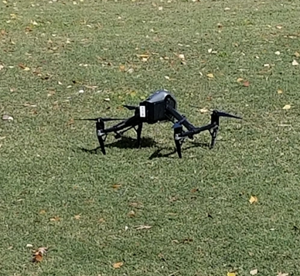
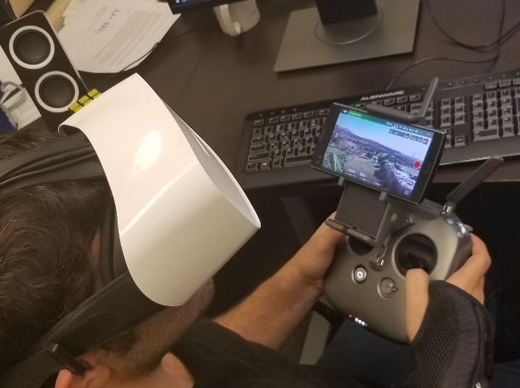
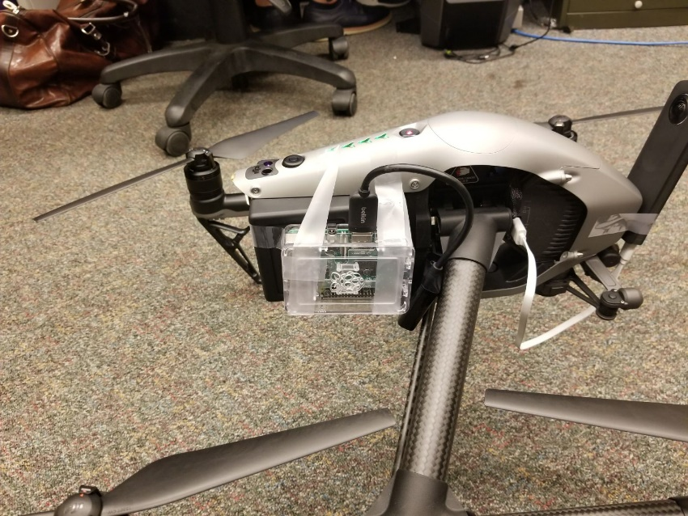
Flight control server
Control instructions received by onboard API and transmitted to UAVs flight control system
User operating the UAV from remote location
Onboard commuter (S1) running the API and communicating with flight control server

Slide 6
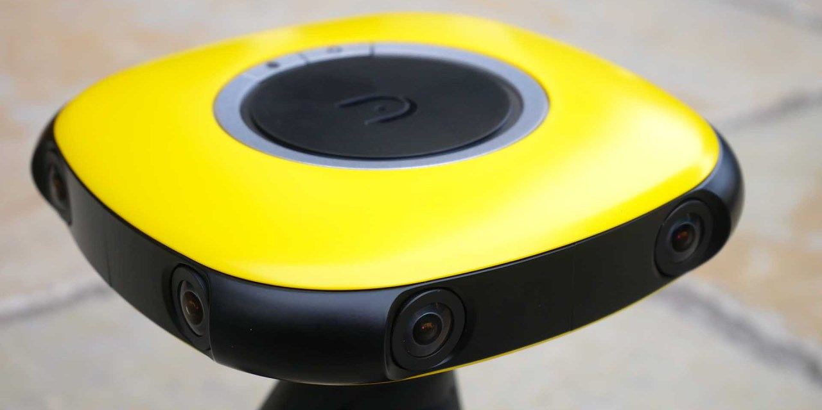
FHD lenses, 180 x 120 FOV

Slide 7
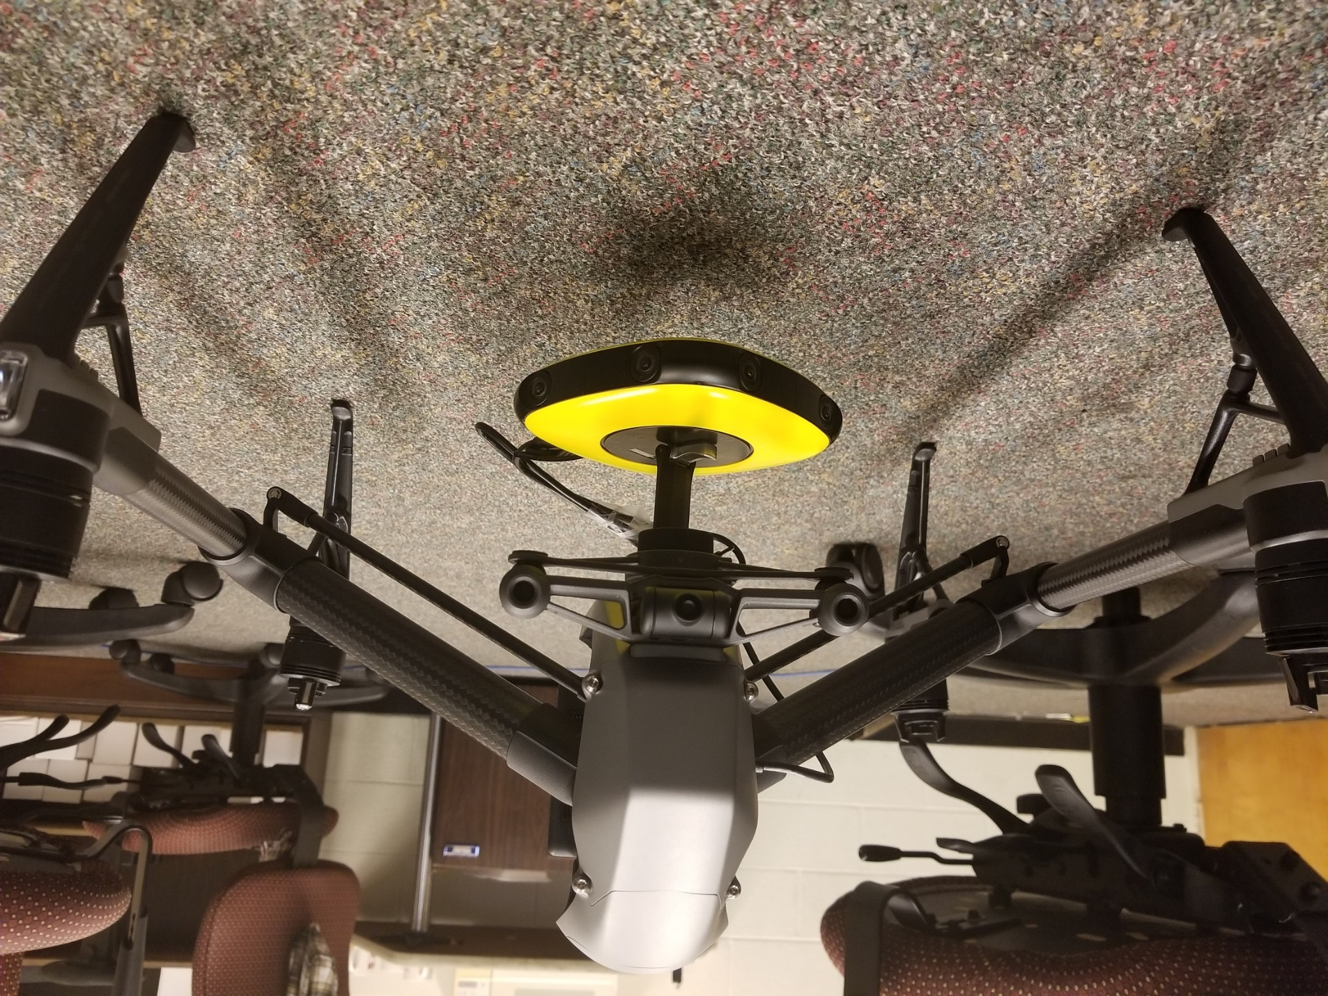
HDMI Connection to S2
FHD lenses, 180 x 120 FOV

Slide 8
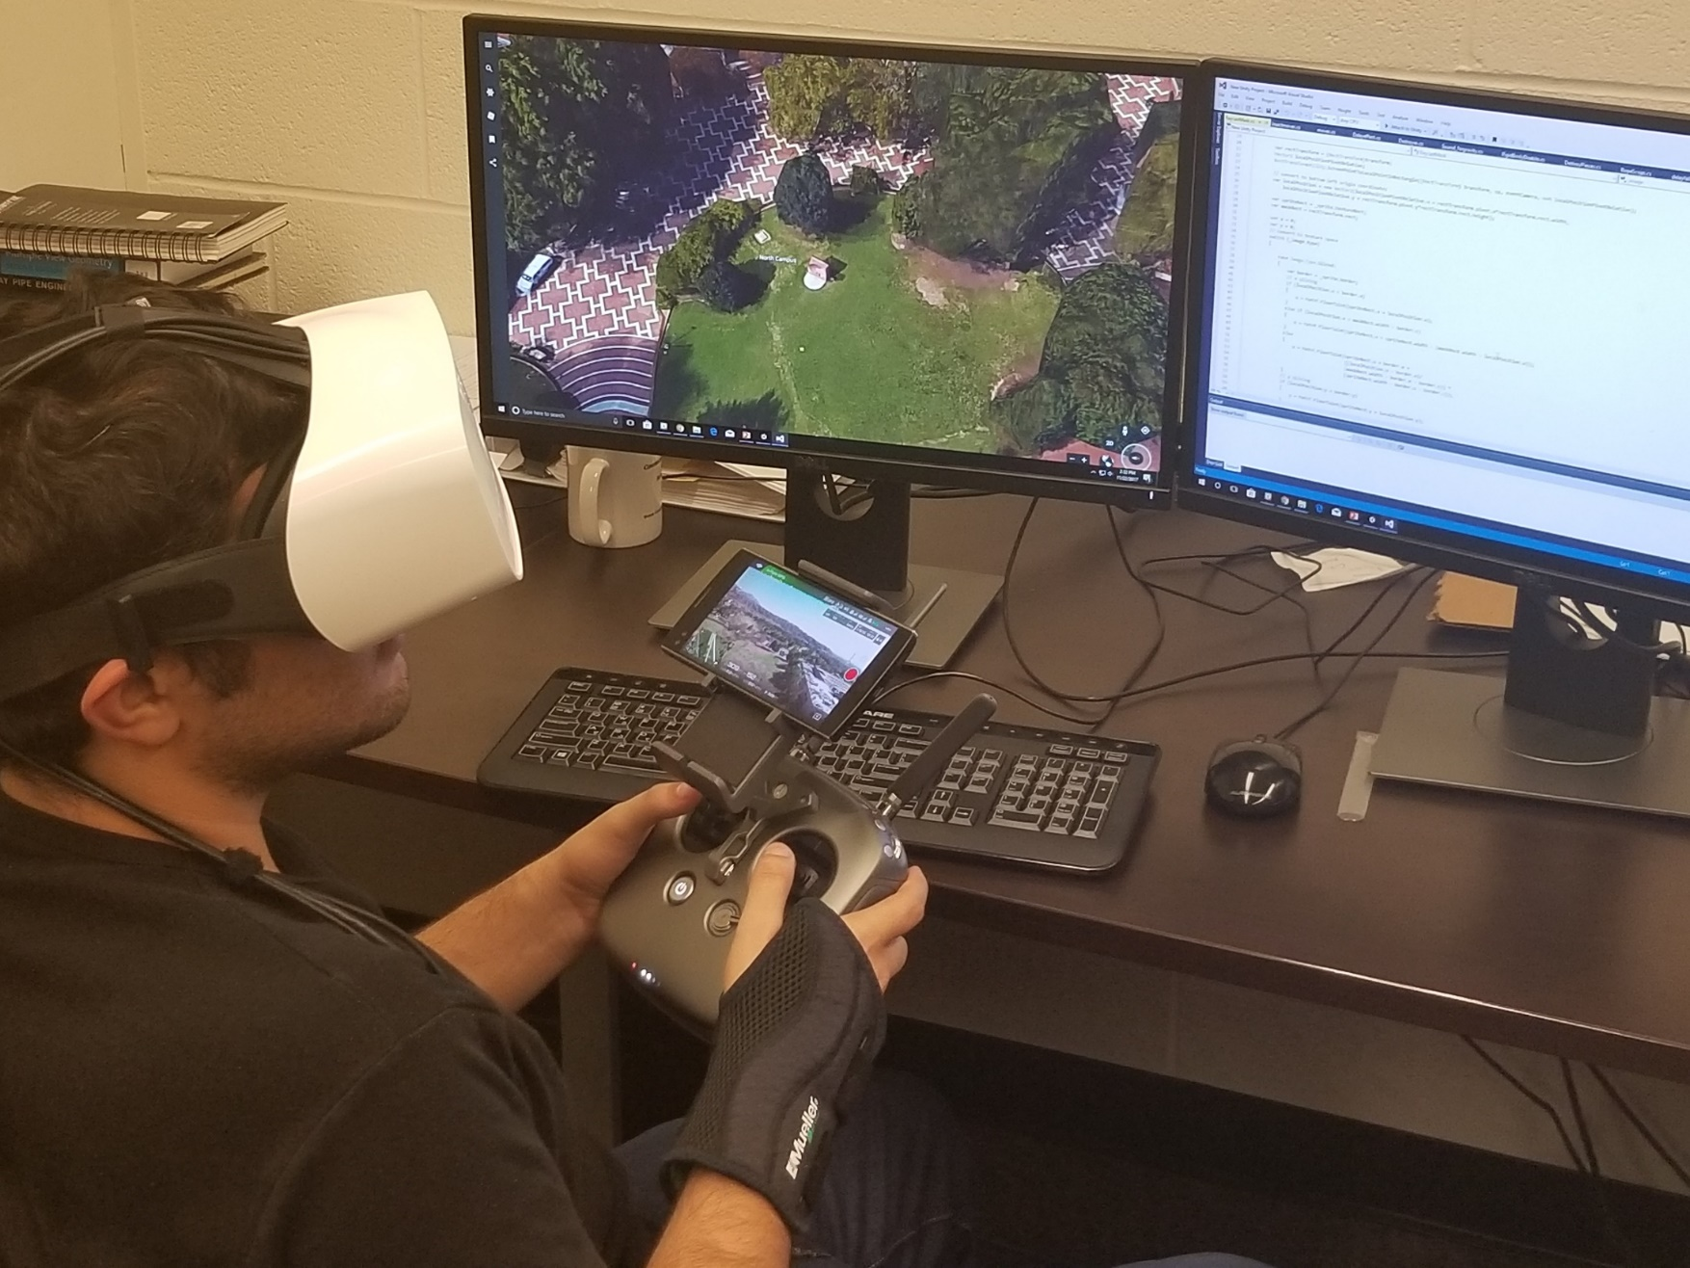
360 scene viewed in Immersive Environment
Data received from server & Processed

Slide 9
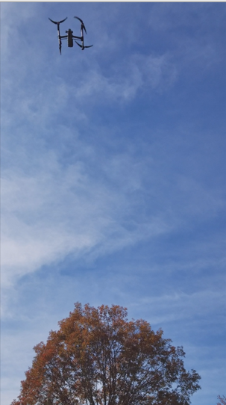
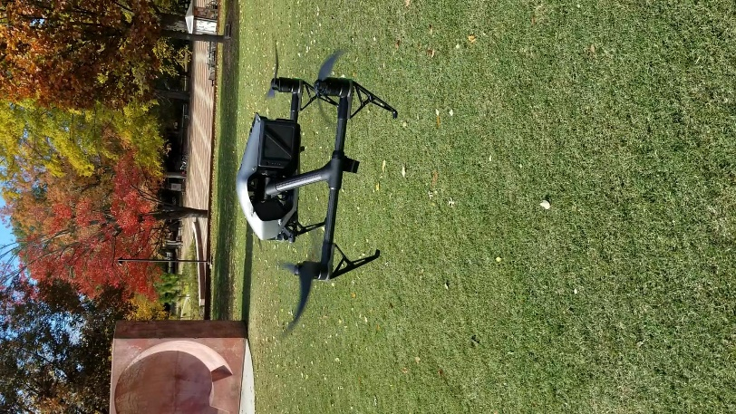
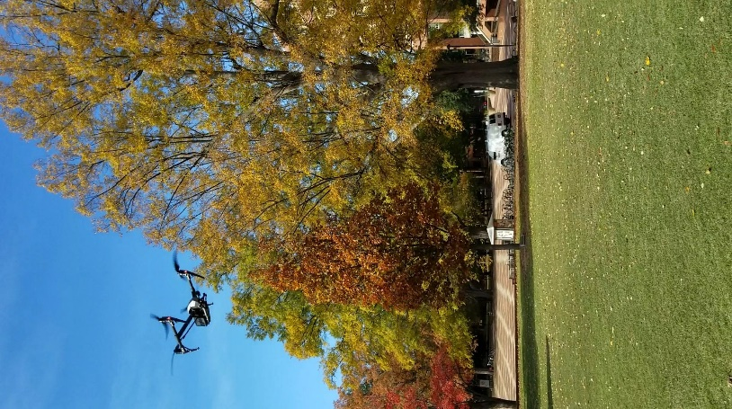
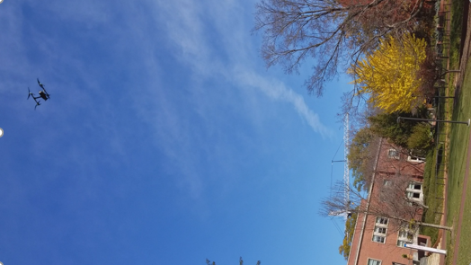

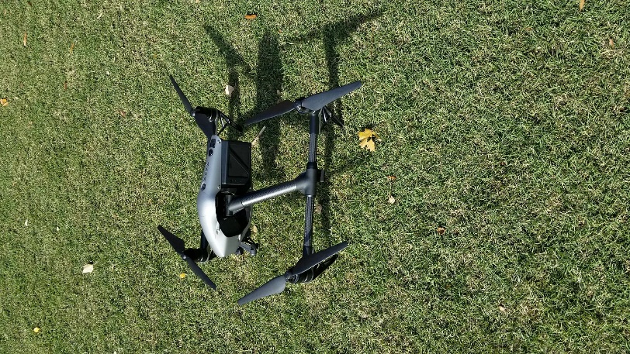
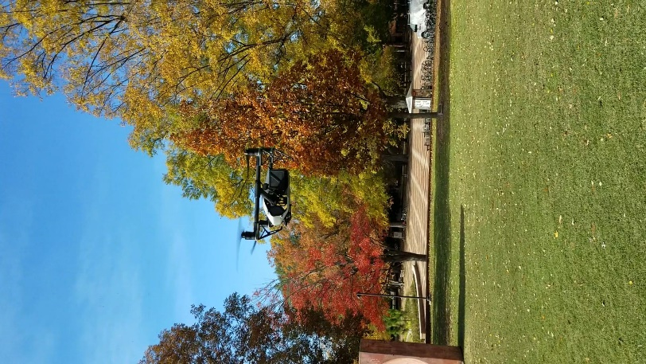
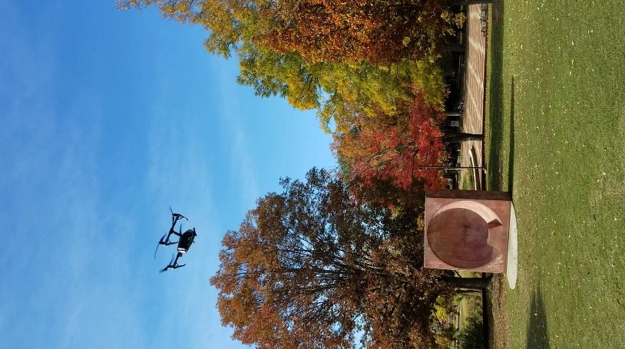


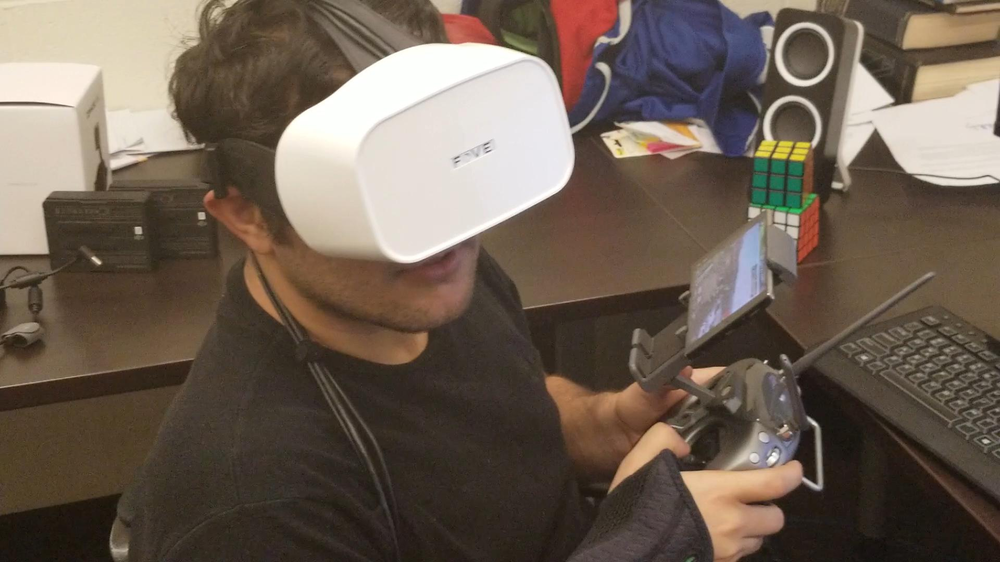
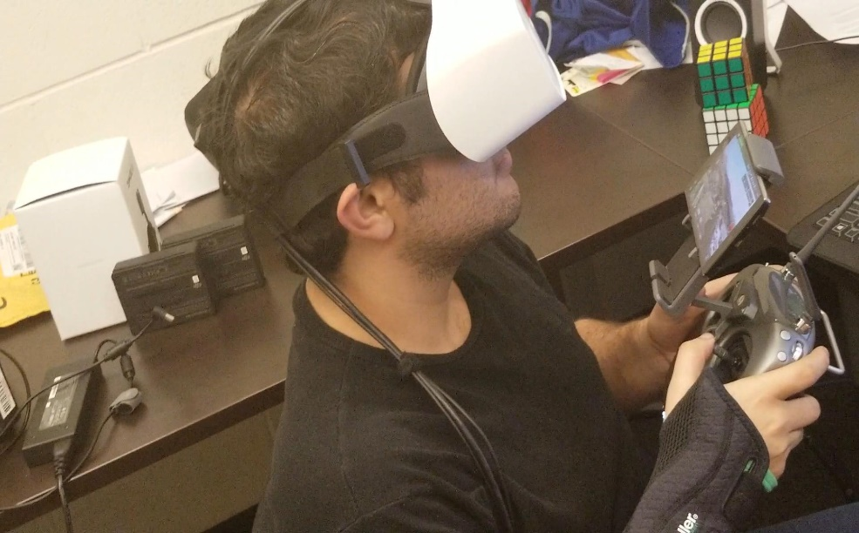
Remote Site Location (DH Hill)
User Location Mann Hall

